Slide 1
“Titanic Disaster” Analysis
Insights on survival rates based on age, gender and other factors
Krasimir Kirilov

Slide 2
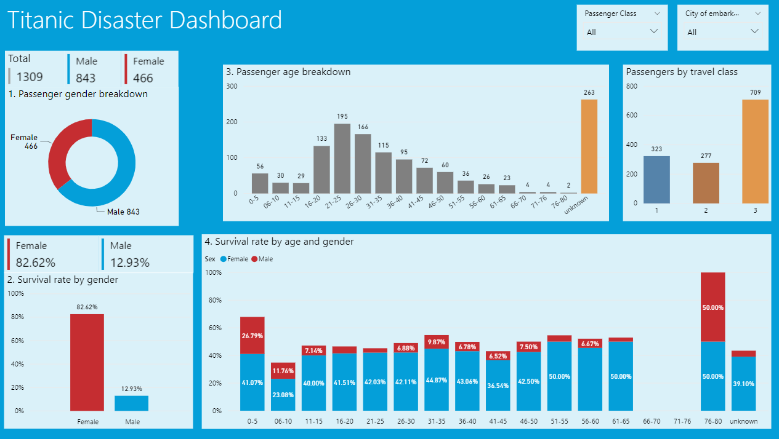
1. Passenger breakdown by gender

Slide 3
2. Passenger survival rate by gender

Slide 4
3. Passenger age breakdown, grouped into five-year intervals.

Slide 5
4. Passenger survival rate by gender and age category.

Slide 6
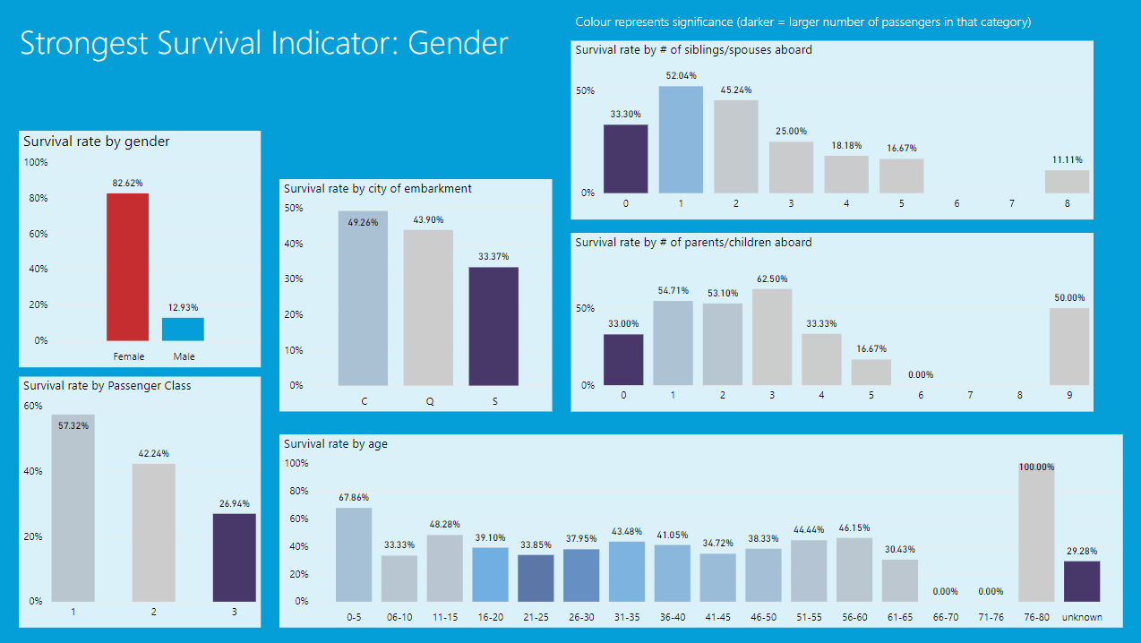
5. Strongest indicator of survival

